Slide 1
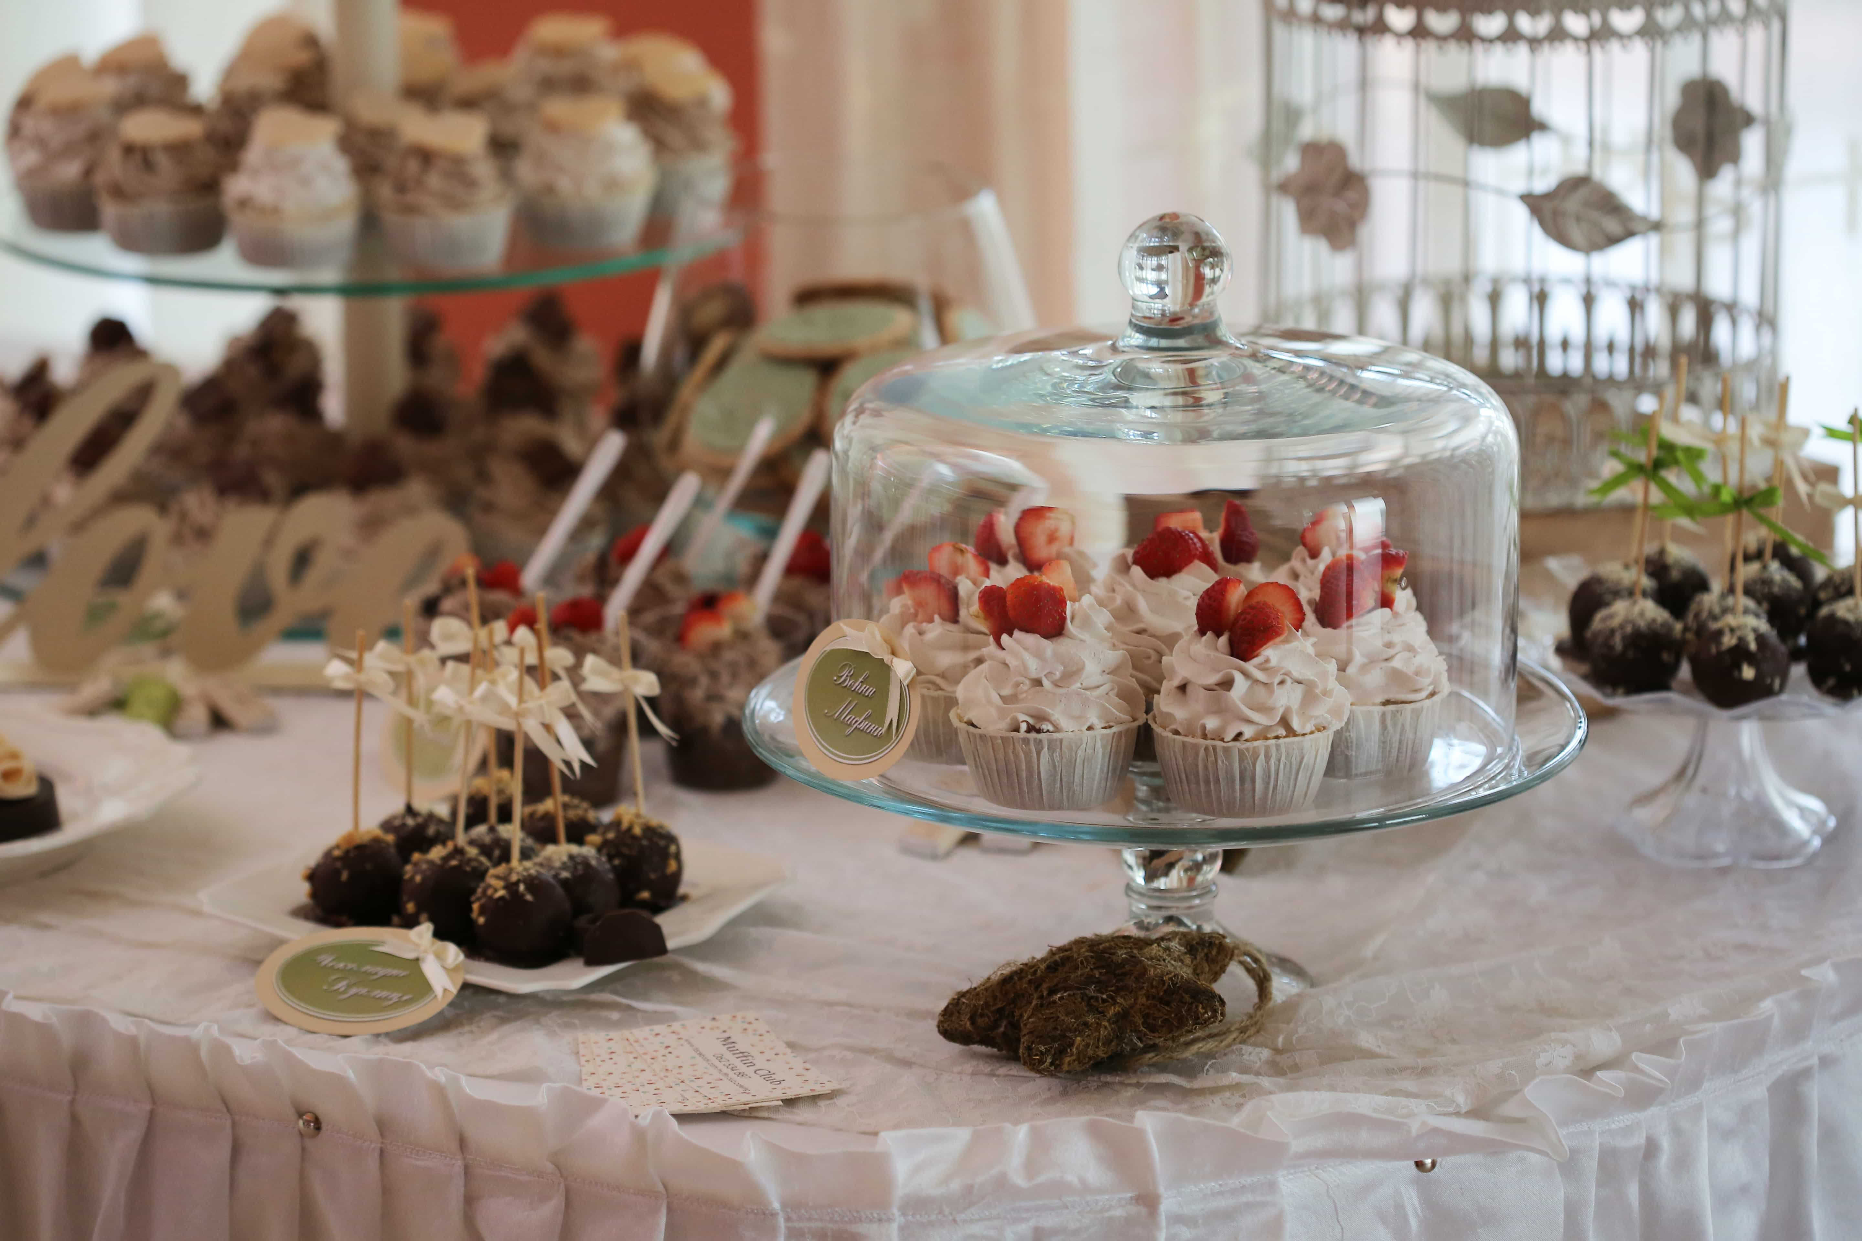
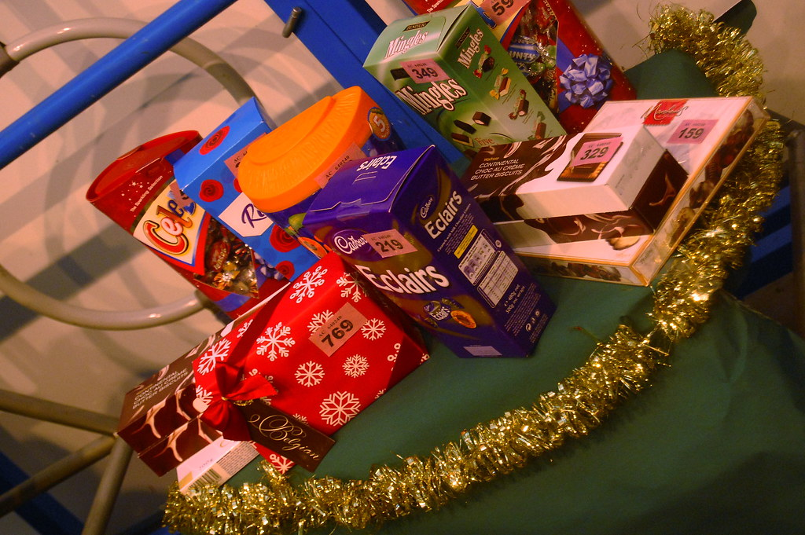
NEWSLETTER
29th November 2024
Safe use of devices and apps
Message from Mrs Gibson
I am delighted that the festive season is nearly upon us and there are lots going on at school.
Enterprise projects are being completed and have been really engaging and exciting for the children.
All the children are busy preparing for their Christmas school performances
(see notice below for times)
Hope to see you all at the school fair on the 5th December. If anyone is having a clear out before Christmas and would like to donate any unwanted gifts, toys or books (in good condition) for our tombola stall please drop them off at the school office. We will also need baked goods for the cake stall.

Slide 2
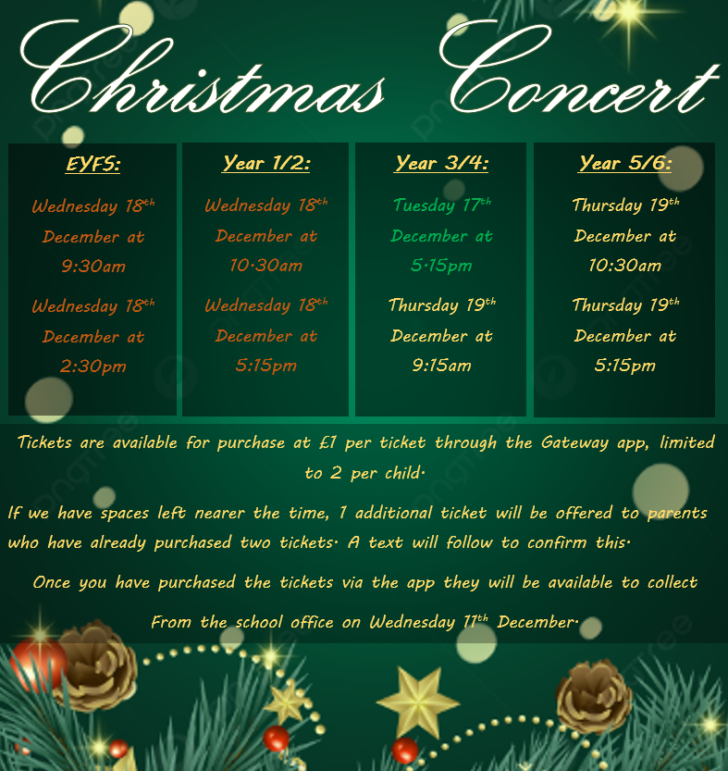
NEWSLETTER
29th November 2024

Slide 3

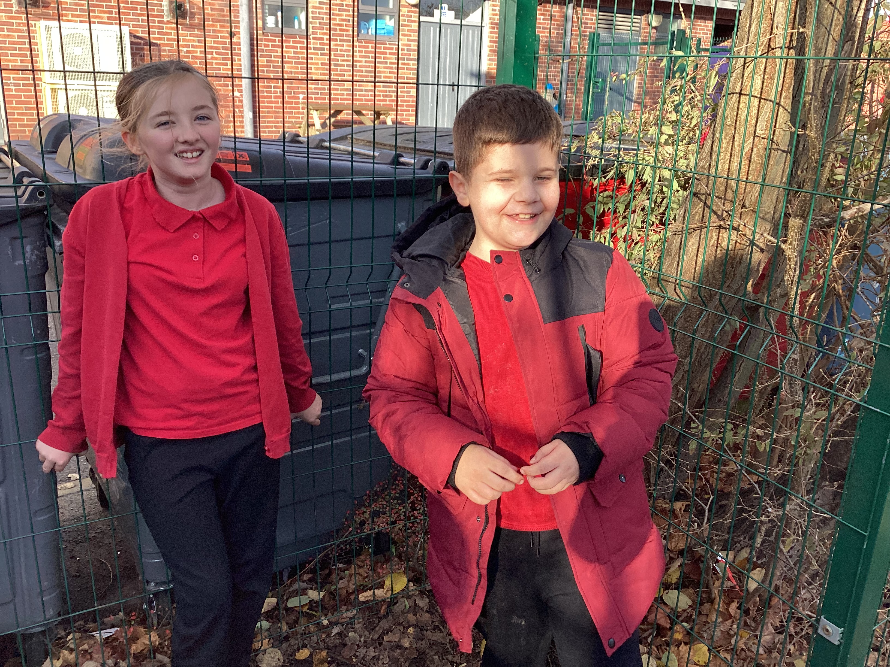
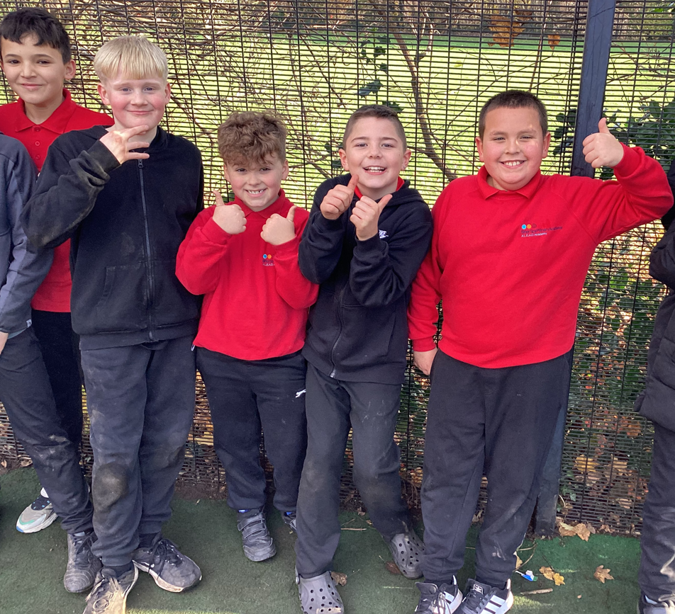
NEWSLETTER
29th November 2024
This week the children have really enjoyed the new zones in the playground. It has been lovely to see children playing in areas of the playground that they might not normally play in, and also with people they might not n
We have introduced four distinct play zones designed to support children’s development in various ways. Each zone offers a space for different activities that contribute to physical, social, and emotional growth:
Zone 1 – Forest Area
This area provides a natural environment where children can engage in quiet activities like colouring, as well as enjoy unstructured playtime outdoors. It offers a calm space for students to connect with nature during their breaks.
Zone 2 – Badminton & Obstacle Course Equipment
In this zone, children can participate in activities such as badminton and use the obstacle course equipment. These activities help develop physical coordination, teamwork and sportsmanship.
Zone 3 – Mushroom & Games Zone
This area is set up for various traditional playground games, encouraging active play. Children use this space to engage in games that promote teamwork, physical fitness and friendly competition.
Zone 4 – Skills Area
The Skills Area features equipment that helps children improve their coordination. It provides a structured environment for students to develop their physical skills and build confidence in their abilities.
I like them
They are teaching kids to play different games
I like them because you get to play with different people from different year groups
I’ve made two new friends

Slide 4







NEWSLETTER
29th November 2024

Slide 5
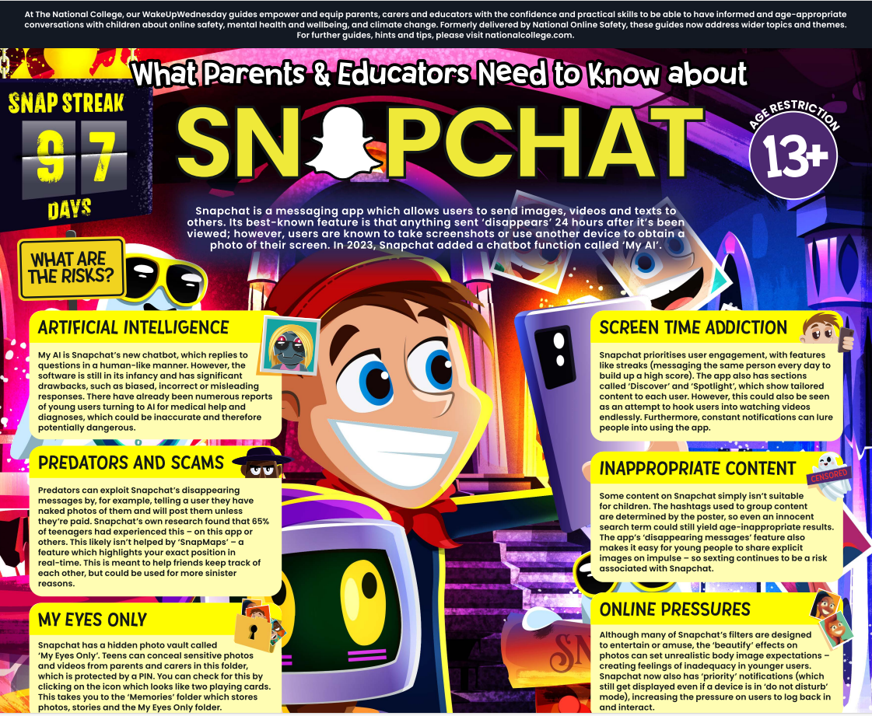

NEWSLETTER
29th November 2024
Safe use of devices and apps

Slide 6

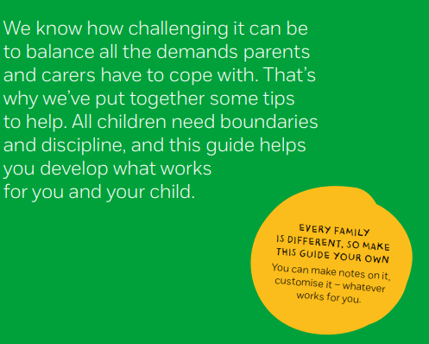
NEWSLETTER
29th November 2024

Slide 7
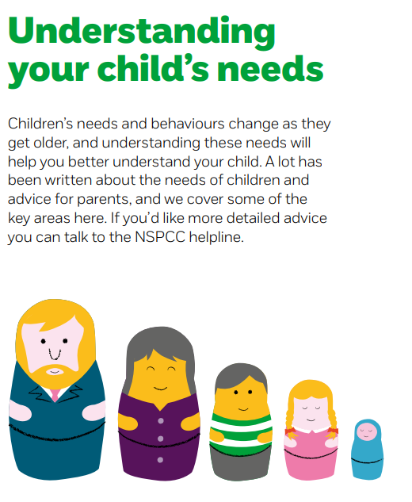
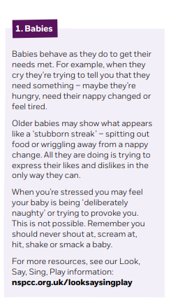
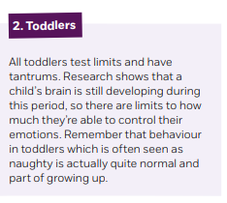
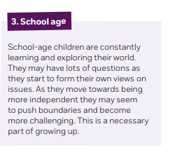
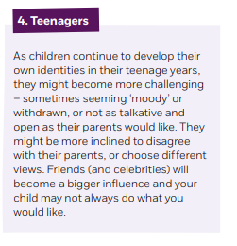
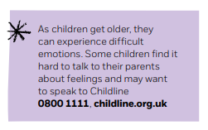
NEWSLETTER
29th November 2024
Safe use of devices and apps

Slide 8

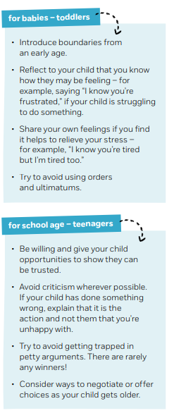
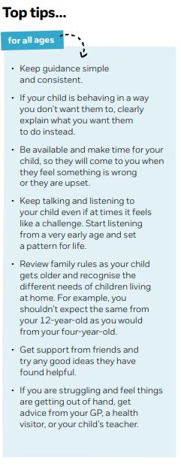

NEWSLETTER
29th November 2024
Safe use of devices and apps

Slide 9
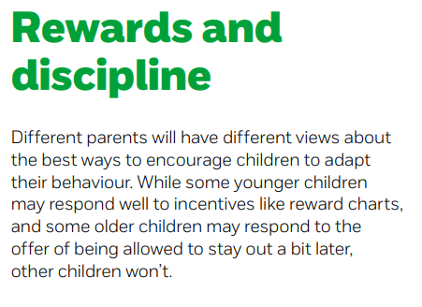

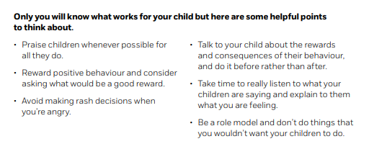
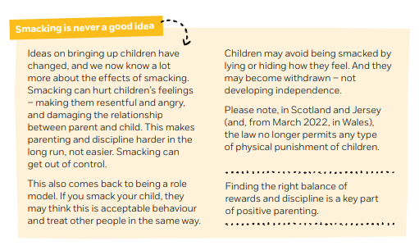
NEWSLETTER
29th November 2024
Safe use of devices and apps

Slide 10
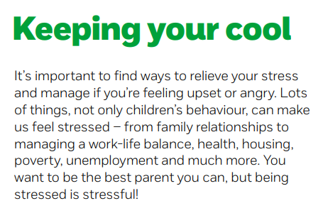

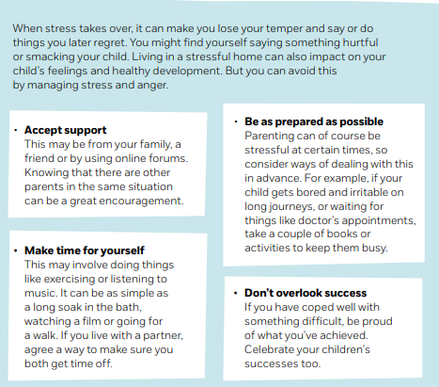
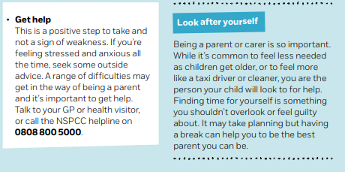
NEWSLETTER
29th November 2024
Safe use of devices and apps

Slide 11
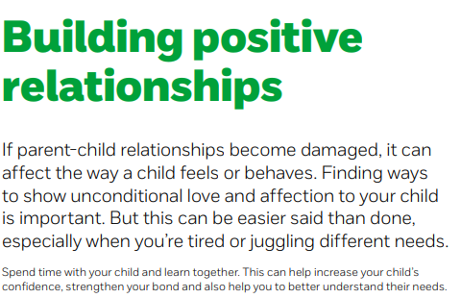
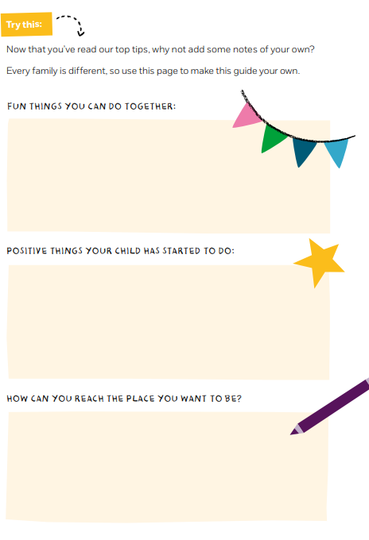
NEWSLETTER
29th November 2024
Safe use of devices and apps

Slide 12
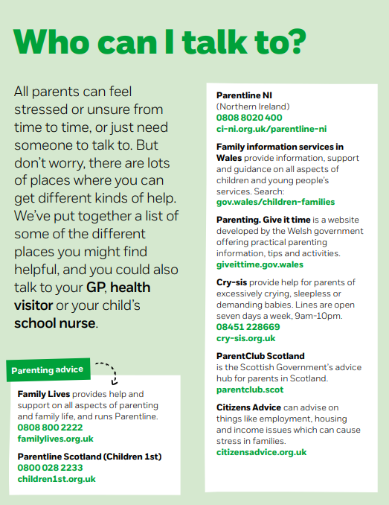
NEWSLETTER
29th November 2024

Slide 13
NEWSLETTER
29th November 2024
Autumn Parent Support
Date | Event
Thursday 5th December | Christmas Fayre
Monday 9th December | Inset Day School closed to pupils
Tuesday 10th - Wednesday 13th December | Book Fair
Wednesday 11th December 2024 8:30am - 9:30am | LEAD IT Safe use of devices and apps Church Service
Thursday 12 December 2024 | Christmas Jumper day Christmas Dinner day
Tuesday 17th December 2024 | Christmas Performance Y3&Y4 – 17.15
Wednesday 18 December | Christmas Performance EYFS - 09.30 & 14.30 Christmas Performance Y1&Y2 - 10.30 & 17.15
Thursday 19 December 2024 | Christmas Performance Y3&Y4 - 09.15 Christmas Performance Y5&Y6 - 10.30 & 17.15
Friday 20th December 2024 | Christmas Parties and raffle draw
Monday 6 January 2024 | School inset day
Tuesday 7 January 2024 | School reopens
Autumn
Date
Event
Wednesday 23rd October 2024
2.30pm – 3pm
Sleep and bedtime routines workshop
Friday 8th November 2024
2.30pm – 3pm
Y6 SATs parents’ workshop
Friday 8th November
2024
2.30pm – 3pm
Year 1 Phonics workshop
Monday 11th November
2.30pm – 3pm
Reception Phonics workshop
TBC
2.30pm – 3pm
Birley Academy Y5/6 parent meeting
Monday 18th November 2024
Parents’ evening
3:30-6pm
Wednesday 20th November 2024
Parents’ evening
3:30 – 5:30pm
Thursday 21st November 2024
2.30pm – 3pm
Managing behaviour at home – boundaries and routines
Monday 25th November 2024
2.30pm – 3pm
Attendance workshop – Every day counts!
Wednesday 11th December 2024
8:30am - 9:30am
LEAD IT
Safe use of devices and apps

Slide 14
STAR OF THE WEEK
25th November – 29th November 2024
Class:
A | Chester- for his positive attitude and for being a helpful and kind member of the Nursery team | Keira- for aspiration and her enthusiasm in all her learning, especially counting
B | Cally - for her aspiration and trying really hard with her maths learning | Sofia- for having an amazing first week at school and joining in with all the activities- Great teamwork
C | Luna-Rose Broadhurst– for showing creativity and aspiration in class. Luna is working really hard to learn the songs and actions for the Christmas performance. | Yousef Salar – For showing empathy towards his friend when he hurt himself. Yousef showed great concern and made sure he was comfortable.
D | Seb- for participation in active English | Carter – for aspiration when writing in English
E | Esmae - for aspiration in her writing. Esmae has beautifully used her phonics to create some wonderful sentences about Lila and the secret of rain! | Tilly for showing all the school values. Tilly has such a positive attitude, works tremendously hard and has pushed herself to create some beautiful writing, art work and really deepen her maths skills!
F | Amelie – for aspiration – Amelie has had high expectations of herself and her presentation in English this week and has felt really proud of her work. | James – for creativity and aspiration – You have made connections to the English language in our French lessons and also challenged yourself with your vocabulary choices in English.
G | Dexter – for showing a fantastic improvement in his attitude to learning. especially proud of how much his confidence in English has improved! | Harper – for showing an improvement in her attitude to maths and showing empathy and tolerance in the discussions during PSHE.
H | Yaran - for having a positive start to Birley Spa. She has shown all the school values in her first week | Maxwell – for showing endeavour with his writing. He has shown a positive attitude and carefully constructed his sentences
I | George – For showing resilience and having a positive ‘I can do it’ mind-set! This has reflected in his learning and led to high quality work being produced. | Ebony – for showing aspiration and getting involved during class/group discussions (helping her own and others learning to progress!) It’s lovely to see Ebony’s confidence continue to grow!
J | Scott – for showing empathy and tolerance in English. You are writing brilliantly as a different character this week. | Jacob- for showing aspiration in maths. You have used a place value slider to help multiply numbers by 10,100 and 1,000- well done!
K | Kian Allen -- for showing empathy and tolerance in ensuring peers make the right choices | Lucia Emes - for aspiration to achieve her best in her fraction work this week.
L | Logan – for having the confidence to put his hand up and share his opinions with the class | Iyla Rose – for increased confidence in maths and for being willing to have a go.
M | Sienna Parkin – for showing aspiration when working really hard in Maths, despite finding it quite challenging. Well done Sienna! ☺

Slide 15


Weekly Attendance
25th November – 29th November 2024
Congratulations to these children who have attended everyday this week!
EYFS |  | KS1 |  | KS2
Mustafa Billie Khenan Ronnie Liylah-Rose Freddie Kenton Helen Bobby Sonny Keira Chester Remi Jenson Layla Jaxon | Ella-Rose Karter Brooke Ada Sofia Penelope River Jack Mylo Rosie Jaxon Holly Brody Cody Noah Maisie Callie Harry Jackson | Parker Archie Oliver Harlee Lylah Logan Freddy Sophie Eliseos Holly Marianna Summer Cooper Eliza Caitlyn Jenson Mailan Isla Elinam Harper Brody Paisley Ross Isaac Ella Isla Grace Bobby Arlo Chloe | Ahmed Ross Rylee Ellie-Mae Louie Isabelle Alfie Mckenzie Ruby Lily Kya Matilda Joshua Precious Neveah Esmae Freddie Charlie Coby Bentley-Jay Archie Carter Georgios Marcie-Mae Lottie Pippa Olivier Rosie Henry Bennie Felicja | Daisy Rae Boe Maisie-Leigh Lily Amie Amelia Max Evie-Rose Drini Teegan Louie Isaac Phoebe James Logan Aniyah Grace Milana Annabelle Layla Eli Poppy Calvin Taylor Darcie Valerie Amelia Flourish Tiffany-Jayne Charlotte Macey Harper-Leigh Coen William Marley Trisha Alice Zac Oliver Colby Margaret Lillie Reggie Alina Ronnie Golnoush Jacey Oscar Ollie Mason Jenson Tayen | Conor Leon Iyla-Rose Charlie Amelia Tyler Alexander Mila Maisey Tommy Ava Lucas WIlliam Amelia Yousuf Oliver James Logan Osca Grace Charlie Theo Layton Piper Maxwell Beryl Ellis Gabriel Anaya Darcy Jaxon Ezra Bryley Alana Poppy-May Darcey Dylan Willow Amelia William Yaran Thomas Kyla Chloe Oscar Lucia Charlie Leo Sophie Albie James Emaleigh | Oliver Jayden Lexi Kavern Ben Isla Caelan Kobie Ebony Jenson Arianna Cheatah Libby Oliver Tayloir Mohammad Mohammed Lacie-Rose Elizabeth Isabelle Lucy Jacob Darcie Leo Jayden Lukas Joshua Harry Alarnie Samuel Scott Evie Gabriel Amelia Freddie Jax Charlie Amelia Lyla Cohan Yousif George Luca Jacob Dianne

