Slide 1
NEWSLETTER
1st December 2023
School Photos:
For those children who could not attend on Wednesday 29th November for their school photos taken, we have arranged a session where those children only have the opportunity to have their photos taken. Children who had their photos taken will not have them taken again.
This session will take place on Friday 12th January 2024.
RE experience
Join us on Wednesday from 2-3pm in your child’s classroom to experience an RE session where children will have a key concept of Religious Education to share with you. We’re looking forward to seeing as many parents as possible.
Thank you
Thank you to Mrs Ibbotson who has worked with our children in the IR. She is moving to a new school and we wish her all the best.
Christmas Fayre Donations:
We are kindly asking for donations of toys, books and other suitable raffle and tombola prizes for our Christmas Fayre this year. Donations will be warmly welcomed at the school office.,
Christmas Concert Tickets:
This year our School Christmas concerts will be held on:
Wednesday 19th December 2023 at 2:00pm – KS1
Thursday 20th December 2023 at 9:30am – EYFS
Thursday 20th December 2023 at 1:30pm – EYFS
Thursday 20th December 2023 at 5:30pm – KS1
Friday 21st December 2023 at 9:15am – KS1
Friday 21st December 2023 at 2:00pm – KS2
Friday 21st December 2023 at 5:30PM – KS2
Tickets will be purchasable via the Gateway App from Wednesday 6th December. Tickets will cost £1.00. Tickets will be available to collect from the school office from Monday 11th December.
Each child will be allocated two tickets.

Slide 2
Year 6
Year 6 Kingswood Trip:
If your child is in Year 6, they should have brought home a letter containing information about their Kingswood residential trip next June.
If you wish for your child to attend please complete the return slip and return this to the school office before Friday 8th December.
We ask parents to pay a deposit of £30.00 before Wednesday 20th December so school can secure your child’s place.
Both full-payment and smaller-multiple payments will be an option to support parents with completing the payment for this trip.

Slide 3

Staying Safe Online!

Slide 4

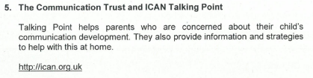


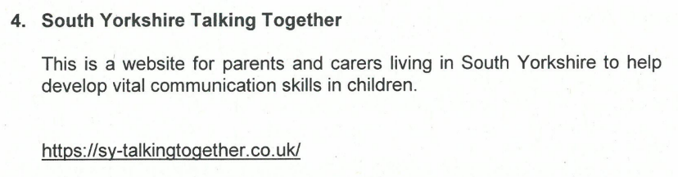
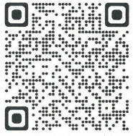
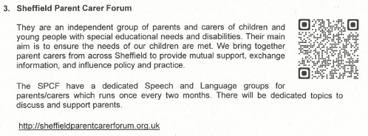
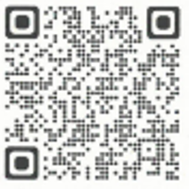
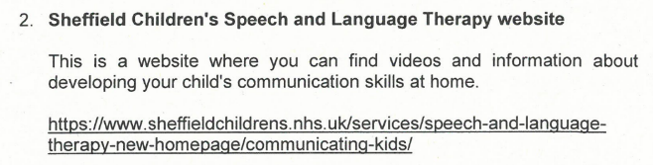
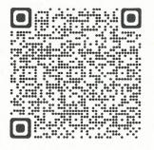
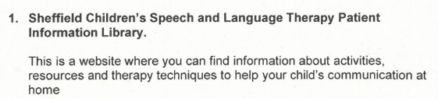
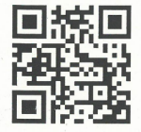
Useful Link for Parents:

Slide 5


Weekly Attendance
27th November – 1st December 2023
EYFS | A | 95.1%
EYFS | B | 95.5%
Y1/Y2 | C | 92.9%
Y1/Y2 | D | 88.6%
Y1/Y2 | E | 84.1%
Y3 | F | 93.3%
Y3 | G | 94.2%
Y4 | H | 90.8%
Y4 | I | 91.7%
Y5 | J | 90%
Y5 | K | 97.2%
Y6 | L | 90.4%
Y6 | M | 92.2%
Y3/Y6 | N | 80.0%
Whole School Attendance |  | 91.6%
At Birley Spa Primary Academy we are committed to helping all pupils to achieve their full potential. Good attendance is a key factor in raising pupils’ attainment and supporting their personal development. Whilst it is appreciated that children are ill from time to time, please think carefully before allowing your child to be absent from school. The chart below provides an indication of how just a few days absence can significantly impact a child’s overall attendance percentage and impede their learning:
Description | Attendance | Whole Days Lost | Lost Hours of Learning
Excellent | 100 – 99% | 0 – 2 | 0 – 10
Good | 98 – 96% | 4 – 7.5 | 20 – 37.5
Requires Improvement | 95 – 91% | 9.5 – 17 | 47.5 – 85
Persistent Absentee | 90 – 86% | 19 – 27 | 95 – 135
Critical | 85 – 80% | 28.5 – 38 | 142.5 – 190

Slide 6
STAR OF THE WEEK
27th November – 1st December 2023
Class:
A | Callie-Rose – Her Teamwork in her group and her growing Aspiration in all her learning. | Maisie – Being king and thoughtful when helping us reach our acts of kindness target.
B | Lylah – Showing great Resilience with her Maths learning. | Ella – showing great Resilience using her Phonics knowledge.
C | Isla – Resilience and Aspiration in all her work | Logan – Resilience and Teamwork when working in P.E.
E | Amelia – Being an absolute superstar. You are a brilliant Role model for other in our class and you always show true Resilience and never give up. | Cullen – Being an absolute superstar. You are a brilliant Role model for others in our class and you always Aspire to do your very best in all your learning.
F | William – Teamwork. For helping others to complete their jobs by explaining the process clearly. | Taylor – Aspiration. For working hard to improve in his 4 times tables.
G | Colby – Creativity – he has flourished in enterprise week, Creating a beautiful, unique piece independently. | Alina – Resilience and Aspiration in all her Maths lessons and homework leading to her being on her silver mathletics certification.
H | Caitlin – Resilience – Caitlin has had a positive attitude and shown great determination within music. | Keaton – Aspiration for 100% attendance and having a positive attitude towards his learning in English.
I | Ben – Showing Endeavour and having a positive attitude when faced with a challenge in R.E. | Oliver – Showing Endeavour and having a positive attitude when faced with a challenge in R.E.
J | To all of J Class – All being absolute superstars and showing a great range of all the values.
K | Jacob – Being a Role model to his classmates by showing Resilience and Aspiration in all his learning. | Maisey – Working hard to develop and implement her knowledge of fractions.
L | Mollie – Showing excellent Endeavour in the mock SATS this week. You have a really positive attitude and are making good progress. | Jaiden – Showing a positive attitude to learning especially in Reading.
M | Evelyn-Lilly – Aspiration – finding a topic that interested her and researching it at home. | Olivia – Resilience in her Maths learning. Olivia is turning into a fraction superstar!
N | Harlie – Teamwork – Harlie has really become part of the class and is developing some great friendships, showing a very caring side.

Slide 7
Dates for the Diary
Date: | Event:
4th December | Student Flu Vaccinations
6th December | RE session with Parents (2pm)
^{8th} December | Christmas Jumper Day
11th December | Phonics with Parents
14th December | Christmas Fayre
19th, 20th, 21st December | Christmas Concerts
22nd December | Christmas Craft Afternoon
25th December – 5th January 2024 8th January | Christmas Holidays INSET day – school closed
9th January 2024 | School Reopens to children
12th January 2023 | Additional individual photo session
12th – 16th February 2024 | Half term Holiday
19th February 2024 | School Reopens for children
19th February 2024 | Young Voices Trip for Year 5
29th March – 12th April 2024 | Easter Holidays
15th April 2024 | School Reopens to children
6th May 2024 | Bank Holiday – School Closed
27th May – 31st May 2024 3rd June | Half term Holiday INSET day – School closed
4th June 2024 | School Reopens for children
23rd July 2024 | Last day of the Academic Year
2nd /3rd September 2024 | INSET Days – School closed

