Slide 1

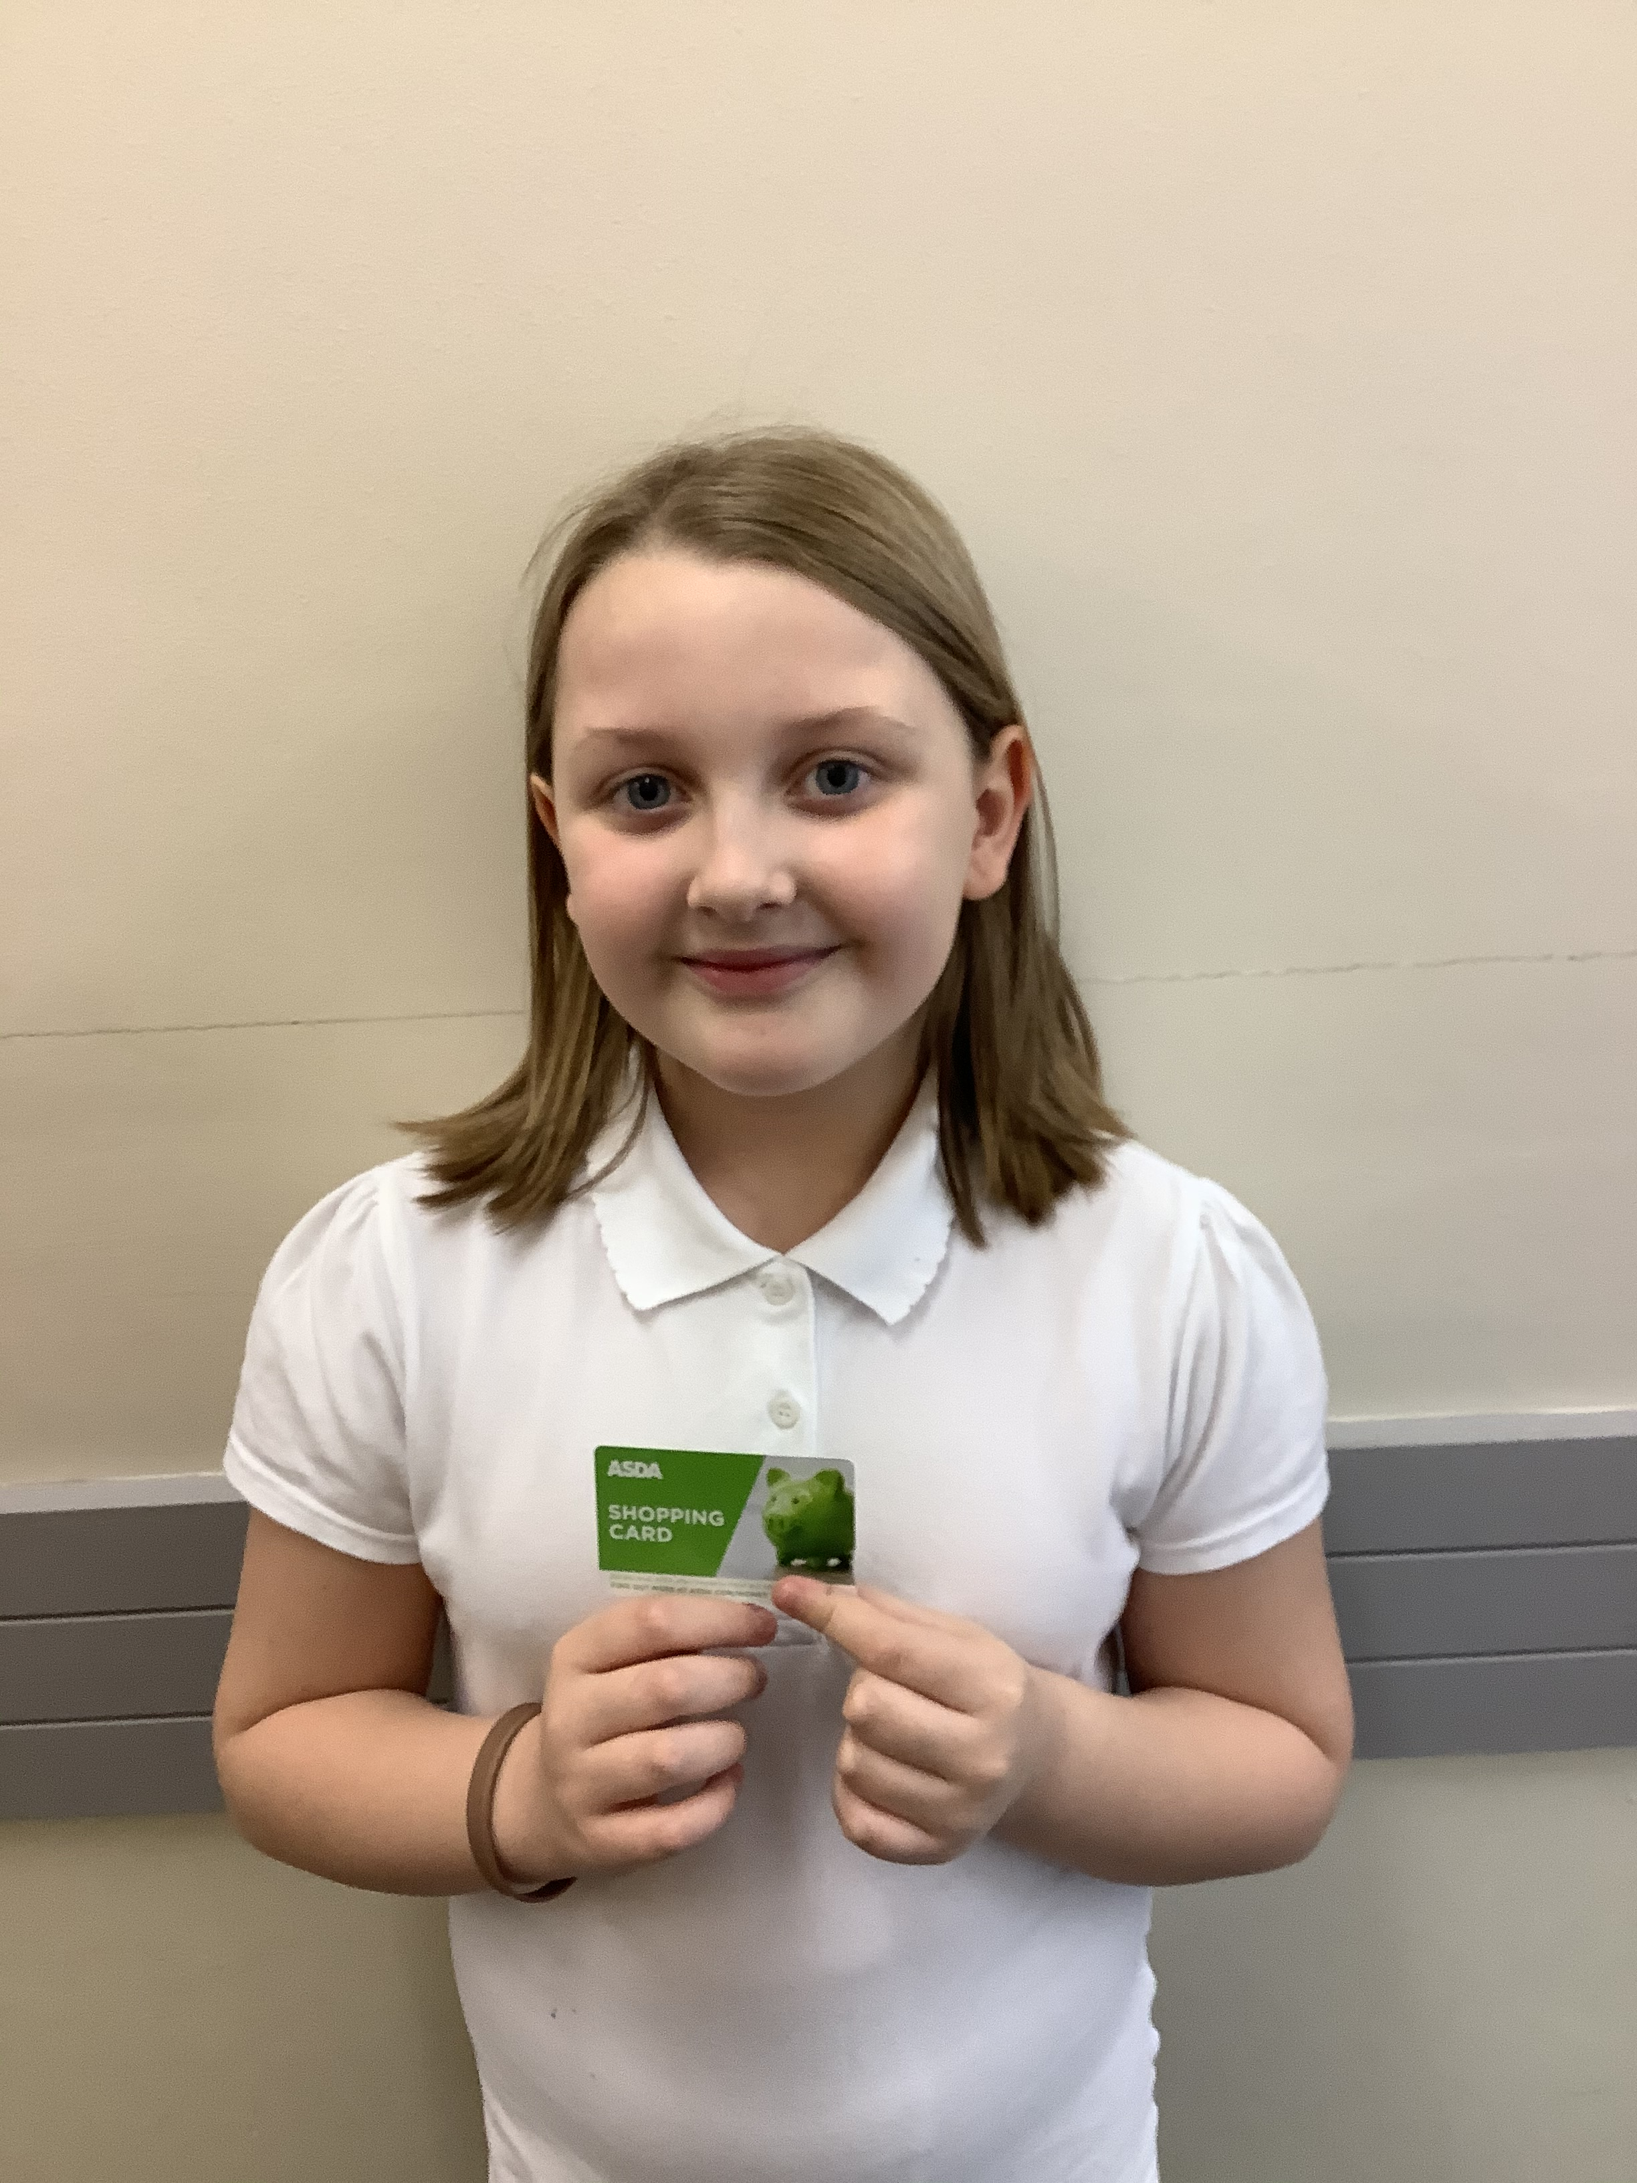
NEWSLETTER
19th January 2024
A message from Mrs Gibson:
This week, we were delighted to meet Alison
Cope, a safety campaigner, who holds
assemblies for Year 5 and 6 children across the country as well as working with teenagers, police, charities, school staff and parents to keep children safe. Alison was delighted with our children’s maturity.
Phonics drop ins
Quick bursts of practice make all the difference for children learning to read.
On Monday 29th January at 2-30pm, EYFS parents are invited in to see how we teach phonics in school and how you can support at home. Please do come as this short session can make a huge difference to your child’s confidence and skills in reading.
This will be followed up on Wednesday 7th February at 9am for EYFS Parents who will be able to practice phonics activities with their children in school. We really look forward to seeing you.
On Monday 5th February, Year 1 parents are invited to meet and discuss the Phonics Screening Check that all Year 1s across the country take in June. This will help parents be clear about what the check means, how it’s used and how your child can be best prepared.
Well done to Alarnie who won the attendance gift card for 100% attendance!

Slide 2

What we’re all about:

Slide 3


Slide 4


Slide 5
STAR OF THE WEEK
15th – 19th January 2024
Class:
A | Eliseos – For endeavour and beginning to use the sounds that he knows to blend into words. | Freddie – For his resilience and taking part in all group activities.
B | Felicja – For her amazing attitude to all her learning. | Jenson – For brilliant manners to both adults and children in class.
C | Charlotte – For teamwork during maths lesson. | Eli – For being resilient during English.
D | Ellie – For teamwork. You are always ready to learn and are willing to help others. | Cooper – For aspiration in his writing. You have really tried hard to do your best.
E | Hattie – For showing super creativity in your writing. Your descriptive menu sounds fantastic with meals such as ‘crazy jacket potato faces with curly, cheesy hair’. | Noah – For showing super creativity in your writing. Your descriptive menu sounds amazing with meals such as ‘ A clown burger with funny sauce’.
F | Tiffany – For aspiration and working hard to complete her tasks and focusing on her own choices. | Macey – For resilience and adapting to change and being understanding to others.
G | Valerie – For resilience. Valerie has been pushing herself really hard to do activities she usually finds hard as she knows it will help her learn. | James – For endeavour and teamwork. James has really been pushing himself in lessons and homework and has been encouraging others to do the same.
H | Jayden – Aspiration and teamwork. Jayden has pushed himself to do his best as well as supporting others to do the same. | Jacob – For aspiration for asking curious questions and pushing himself to the next level.
I | Archie – For showing aspiration in writing and identifying how to move his learning to the next level. | Ben – For showing aspiration in writing and identifying how to move his learning to the next level.
J | Oliver – For being so resilient in maths. That eureka moment was something special! | Albie – For always showing aspiration and trying his best.
K | Charlie – For aspiration and empathy. While Charlie has been working very hard in Maths and excelling. He has also showed empathy by helping his classmate. | Maisie – For resilience. Maisie has really impressed us with resilience towards maths. She has been working very hard.
L | Daniel – For being an excellent role model with completing home learning and reading at home. | Jamelia – For being an excellent role model with completing home learning and reading at home.
M | Daniel – For showing determination and aspiration in reading. You are challenging yourself and becoming more confident. | Chloe – For your progress in English. Your handwriting and presentation is improving. Well done foe being resilient.
N | Harry and Harlie– For endeavour. They have been working in Class I for maths and have done so well; we are all very proud of them. Well done boys!

Slide 6


Weekly Attendance
15th – 19th January 2024
Whole School target: 96%
EYFS | A | 89.3%
EYFS | B | 90%
Y1/Y2 | C | 92.5%
Y1/Y2 | D | 95.4%
Y1/Y2 | E | 91.5%
Y3 | F | 90%
Y3 | G | 96.3%
Y4 | H | 89.2%
Y4 | I | 95.4%
Y5 | J | 85.9%
Y5 | K | 92.8%
Y6 | L | 93.3%
Y6 | M | 90%
Y3/Y6 | N | 86.7%
Whole School Attendance |  | 91.4%
At Birley Spa Primary Academy we are committed to helping all pupils to achieve their full potential. Good attendance is a key factor in raising pupils’ attainment and supporting their personal development. In line with DfE and Local Authority policy, we do not authorise holidays taken in school time and we work with families to do everything they can to support their child to attend school every day. Whilst it is appreciated that children are ill from time to time, please think carefully before allowing your child to be absent from school. The chart below provides an indication of how just a few days absence can significantly impact a child’s overall attendance percentage and impede their learning:
Description | Attendance | Whole Days Lost | Lost Hours of Learning
Excellent | 100 – 99% | 0 – 2 | 0 – 10
Good | 98 – 96% | 4 – 7.5 | 20 – 37.5
Requires Improvement | 95 – 91% | 9.5 – 17 | 47.5 – 85
Persistent Absentee | 90 – 86% | 19 – 27 | 95 – 135
Critical | 85 – 80% | 28.5 – 38 | 142.5 – 190

Slide 7
Dates for the Diary
Date: | Event:
12th – 16th February 2024 | Half term Holiday
19th February 2024 | School Reopens for children
19th February 2024 | Young Voices Trip for Year 5
8th March 2024 | Mother’s day afternoon tea 2pm, 2.45pm and 3.30pm
11th March 2024 | Mother’s day afternoon tea 2pm, 2.45pm and 3.30pm
29th March – 12th April 2024 | Easter Holidays
15th April 2024 | School Reopens to children
6th May 2024 | Bank Holiday – School Closed
27th May – 31st May 2024 3rd June | Half term Holiday INSET day – School closed
4th June 2024 | School Reopens for children
14th June 2024 | Father's Day breakfast 8am, 8:30am and 9am
17th June 2024 | Father's Day breakfast 8am, 8:30am and 9am
23rd July 2024 | Last day of the Academic Year
2nd /3rd September 2024 | INSET Days – School closed

