Slide 1
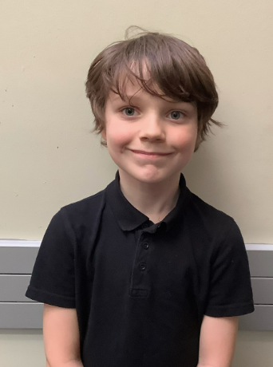
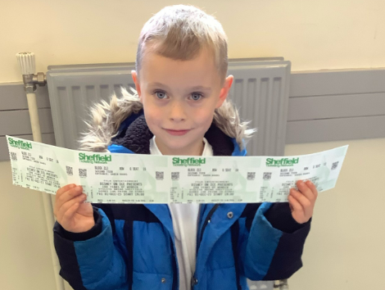
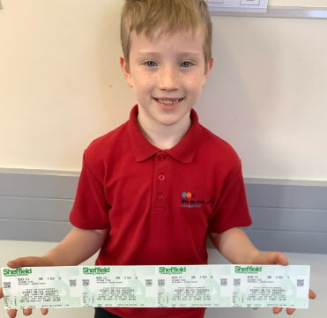
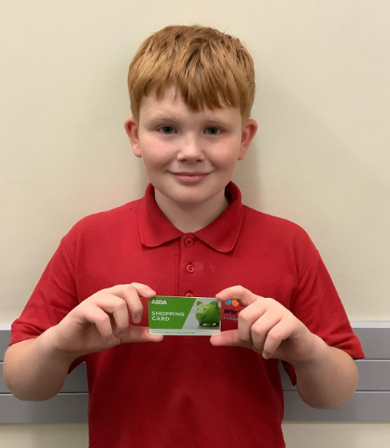
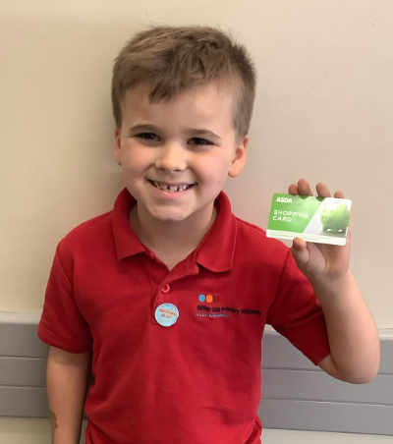

NEWSLETTER
10th November 2023
Excellent Empathy from Eddie!
A huge shout out to Eddie from our Eco Council for amazing Empathy towards his classmates with a brilliant idea of providing some fruit bowls for both Year 3 classes to make sure that there is spare fruit for anyone who needs it.
This idea will be replicated throughout Key Stage 2 so that any child can access spare fruit. If you have a spare piece of fruit when sending your child’s snack and you can donate it to the class supply, this would be very much appreciated.
Disney on Ice!
Well done to our first set of winners of Disney on Ice tickets! Both Ronnie and Cealan have won themselves and their family tickets to attend Disney on Ice at Sheffield Arena by achieving 100% attendance in the first term of this academic year! The children were put into a random draw that was pulled in our Attendance assembly on Friday!
Weekly Attendance Reward:
Well done to this week’s 100% attendance reward winner: Oliver and Marley!

Slide 2
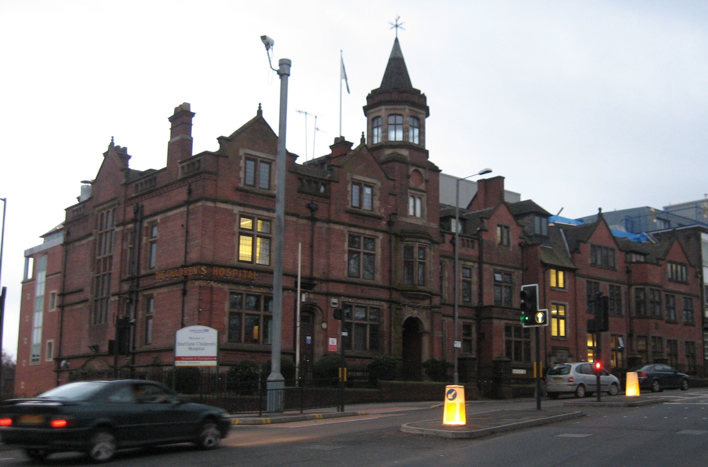

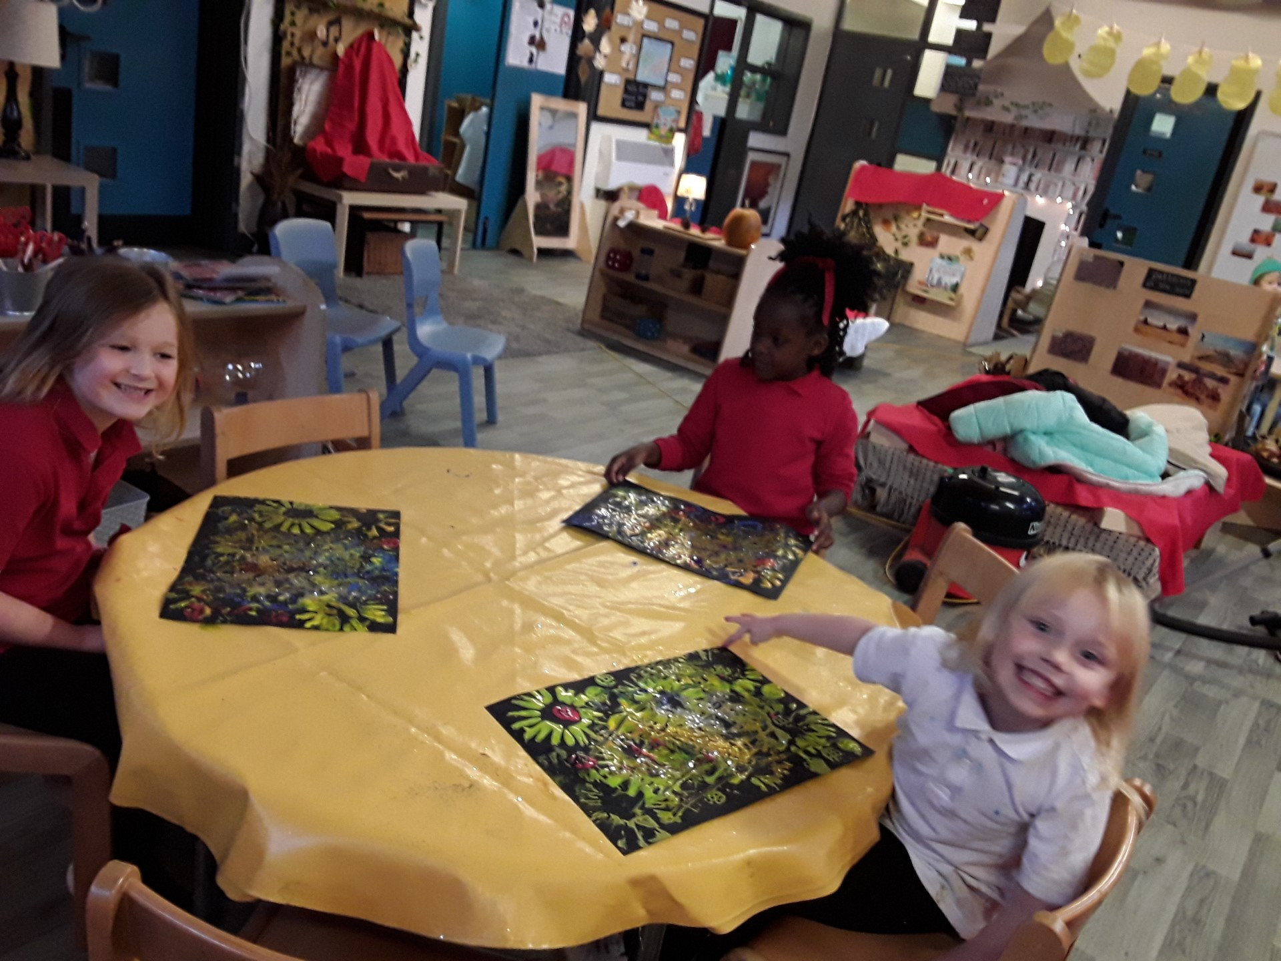
Birley Spa’s Snowflake!
On Friday 1st December, we are asking children to attend school in their Pyjamas to raise money in support of The Children’s Hospital. Participating children are asked to bring £1.00 to their classroom on the day.
This year we are sponsoring a ‘Christmas snowflake’ meaning that Birley Spa’ will have our own school name on a snowflake which is displayed on the Children's Hospital in Sheffield City Centre.
Lifestyle opportunity clubs:
A kind reminder to parents who have booked their child onto a Lifestyle Opportunity Club, Payment via the school gateway is needed for these children to continue attending.
If you are struggling to complete payment, please contact the school office for assistance on 0114 239 9106 or alternatively message the School Gateway.
Last week in Design Club, the children were making firework paintings!

Slide 3

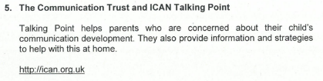


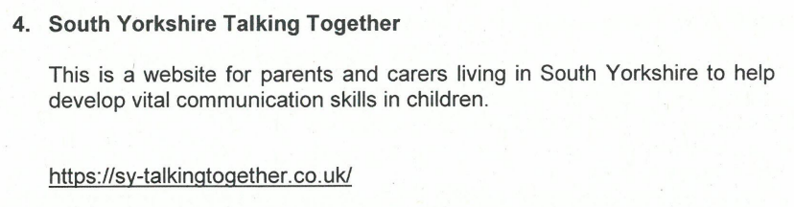
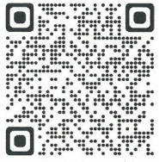
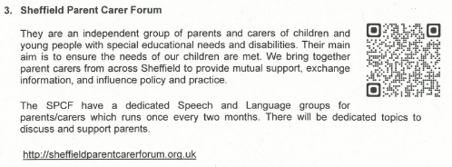
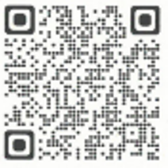
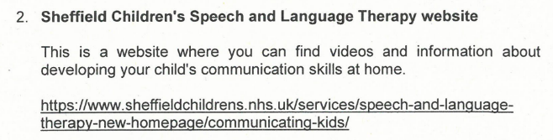
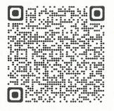
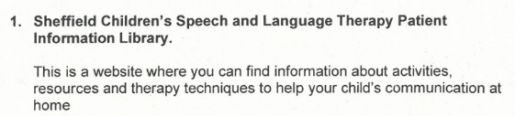

Useful Link for Parents:

Slide 4

Staying Safe Online!

Slide 5
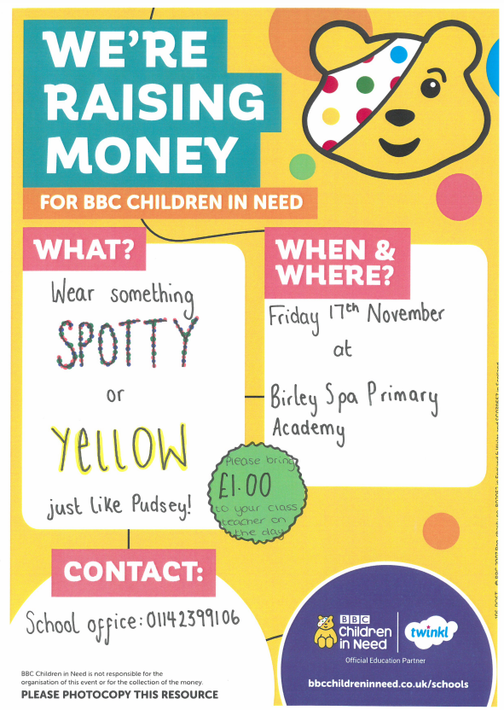
Children in Need!

Slide 6

The National Sleep Helpline

Slide 7


Weekly Attendance
6th – 10th November 2023
EYFS | A | 94.5%
EYFS | B | 93.4%
Y1/Y2 | C | 94.6%
Y1/Y2 | D | 88%
Y1/Y2 | E | 93%
Y3 | F | 95.6%
Y3 | G | 92.5%
Y4 | H | 92.6%
Y4 | I | 97.9%
Y5 | J | 97.2%
Y5 | K | 97.2%
Y6 | L | 93.8%
Y6 | M | 93.7%
Y3/Y6 | N | 91.1%
Whole School Attendance |  | 94%
Well done to: Class I, J, K for achieving over 96%!
At Birley Spa Primary Academy we are committed to helping all pupils to achieve their full potential. Good attendance is a key factor in raising pupils’ attainment and supporting their personal development. Whilst it is appreciated that children are ill from time to time, please think carefully before allowing your child to be absent from school. The chart below provides an indication of how just a few days absence can significantly impact a child’s overall attendance percentage and impede their learning:
Description | Attendance | Whole Days Lost | Lost Hours of Learning
Excellent | 100 – 99% | 0 – 2 | 0 – 10
Good | 98 – 96% | 4 – 7.5 | 20 – 37.5
Requires Improvement | 95 – 91% | 9.5 – 17 | 47.5 – 85
Persistent Absentee | 90 – 86% | 19 – 27 | 95 – 135
Critical | 85 – 80% | 28.5 – 38 | 142.5 – 190

Slide 8
STAR OF THE WEEK
16th – 20th October 2023
Class:
A | Lylah – Her Endeavour in Phonics and for being a kind and supporting friend. | Layla – Showing Empathy and Tolerance and always being helpful and kind.
B | Isabelle – Being super helpful and showing great Teamwork. | Felicja – Showing her Creative talent through her amazing Art work.
C | Marley – Resilience and Aspiration in Maths and Literacy. | Emily – Showing Aspiration in Active English and applying what she has learnt in her writing.
D | Gabriel - Resilience when learning fact families. | Isla - Aspiration in phonics always trying her best.
E | Matilda – Endeavouring to do your very best in all your learning and for showing true Resilience with some tricky Maths. | Layton – Endeavouring to do your best in all your lessons. This week you have listened carefully to your teachers and completed your tasks.
F | Willow – Aspiration – working hard and focusing on exchanging hundreds and tens in Maths this week. | Eddie – Showing Empathy by having an idea to share fruit snacks with other children.
G | Valerie – Resilience – Trying really hard to make new friends and settle into her new class and school really well. | Poppy – Aspiration – Having a constant, hard-working attitude and settling a beautiful example to the rest of the class.
H | Kenley – For Resilience. Kenley is becoming more and more independent and resilient within his learning. This week Kenley has not given up and tried his very best, particularly when it comes to his English work and spelling! | Oliver – For Endeavour. Oliver is always going the extra mile in every lesson. He is also great at ignoring any distractions and stays focussed at all times!
I | Alarnie – Showing Aspiration in her reading lessons. | Darcie – Showing all the school values in and out of the classroom.
J | Mila – Showing all the school values and constantly trying her best. | Tayen – Showing Creativity throughout P.E.
K | Jayden – Aspiration – Jayden has made huge progress in all subjects and this is simply because he always sets himself high targets and ensures he’s always engaging in lessons. | Cohan – Resilience – I am extremely proud of Cohan’s achievements he had made in Reading. He has been Resilient learning his sounds again and is reading fluently.
L | Ella – Showing high Aspiration in all lessons. Ella is working hard and making good progress. | Joshua – Showing excellent enthusiasm in all lessons. Joshua really enjoyed our World War topic in History.
M | All of Class M – For working as a team with Aspiration and Resilience to create some fantastic work.
N | Logan – Endeavour – Logan has worked really hard in all Maths lessons this week. Showing he understands the value of digits in 4-digit numbers.

Slide 9
Dates for the Diary
Date: | Event:
23rd November | Reading with Parents
29th November | School Individual Photos
4th December | Student Flu Vaccinations
6th December | Science experiments with Parents
11th December | Phonics with Parents
14th December | Christmas Fayre
19th, 20th, 21st December | Christmas Concerts
22nd December | Christmas Craft Afternoon
25th December – 5th January 2024 8th January | Christmas Holidays INSET day – school closed
9th January 2024 | School Reopens to children
12th – 16th February 2024 | Half term Holiday
19th February 2024 | School Reopens for children
19th February 2024 | Young Voices Trip for Year 5
29th March – 12th April 2024 | Easter Holidays
15th April 2024 | School Reopens to children
6th May 2024 | Bank Holiday – School Closed
27th May – 31st May 2024 3rd June | Half term Holiday INSET day – School closed
4th June 2024 | School Reopens for children
23rd July 2024 | Last day of the Academic Year
2nd /3rd September 2024 | INSET Days – School closed

